Slide 1
Genmo Combo:
Bridging Mental Health, Genetics, and Clinical Trials with LLM and Sentiment Analysis
Tingyu ‘Tara’ Liu, MS CSE Candidate
tliu479@gatech.edu
2024/11/21
Notes:
Good morning, everyone. My name is Tingyuliu, and today I’m excited to present my project, Genmo Combo(which is an abbreviation of genetics and mental disease combo community): Bridging Mental Health, Genetics, and Clinical Trials. This project explores how we can leverage advanced technologies like sentiment analysis and Retrieval-Augmented Generation to better assist patients with genetic-linked mental disorders.

Slide 2
Index
Background
Motivation
Problem
Related Work
Method
Data
Result
Evaluation
Reference

Slide 3
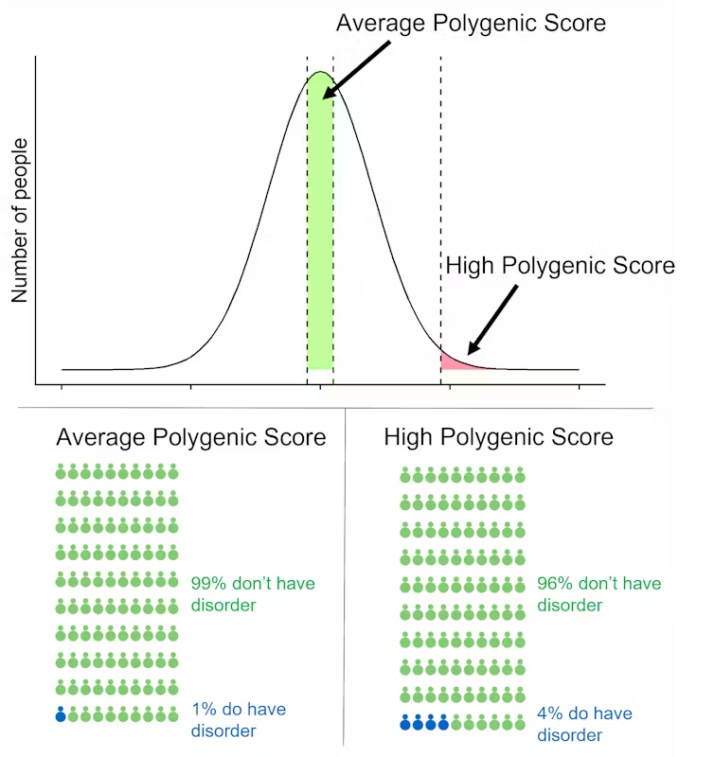
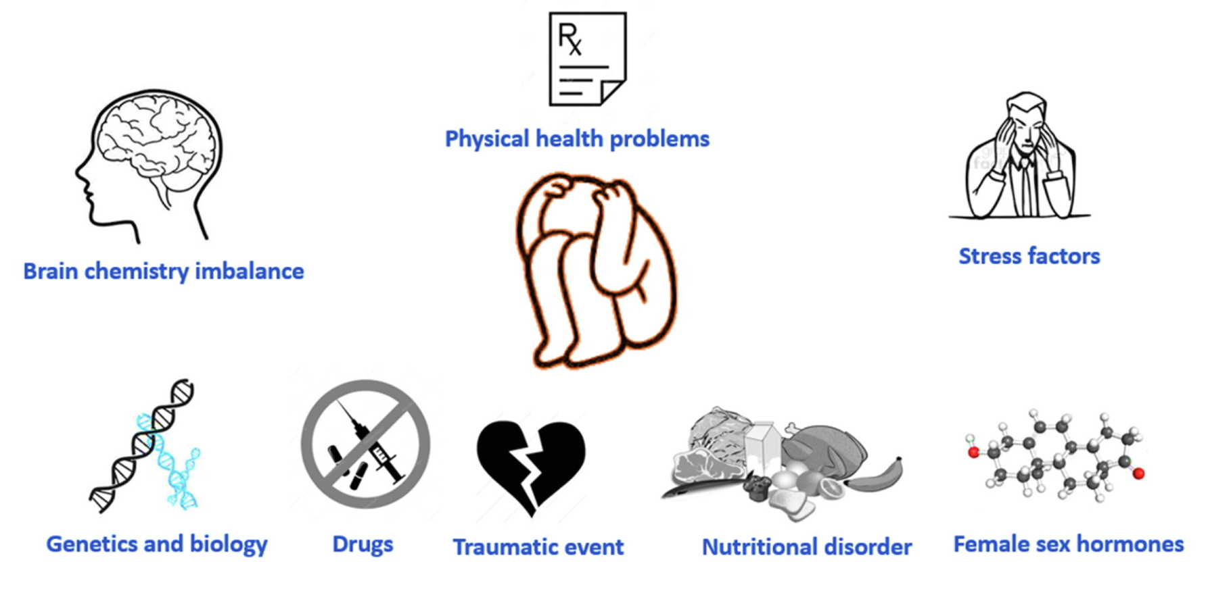
Background
Mental disorders (eg. depression, anxiety) are the result of a combination of environment and genetic variation.
Major Cause of Depression[1]
Genetics Role of Disease[2]
Notes:
Mental disorders, such as depression and anxiety, often result from a mix of life experiences, environmental factors, and genetic variations. Patients with both mental health and genetic disorders face significant challenges, especially in finding tailored support and clinical trial opportunities. This dual complexity highlights the need for innovative, patient-focused solutions

Slide 4
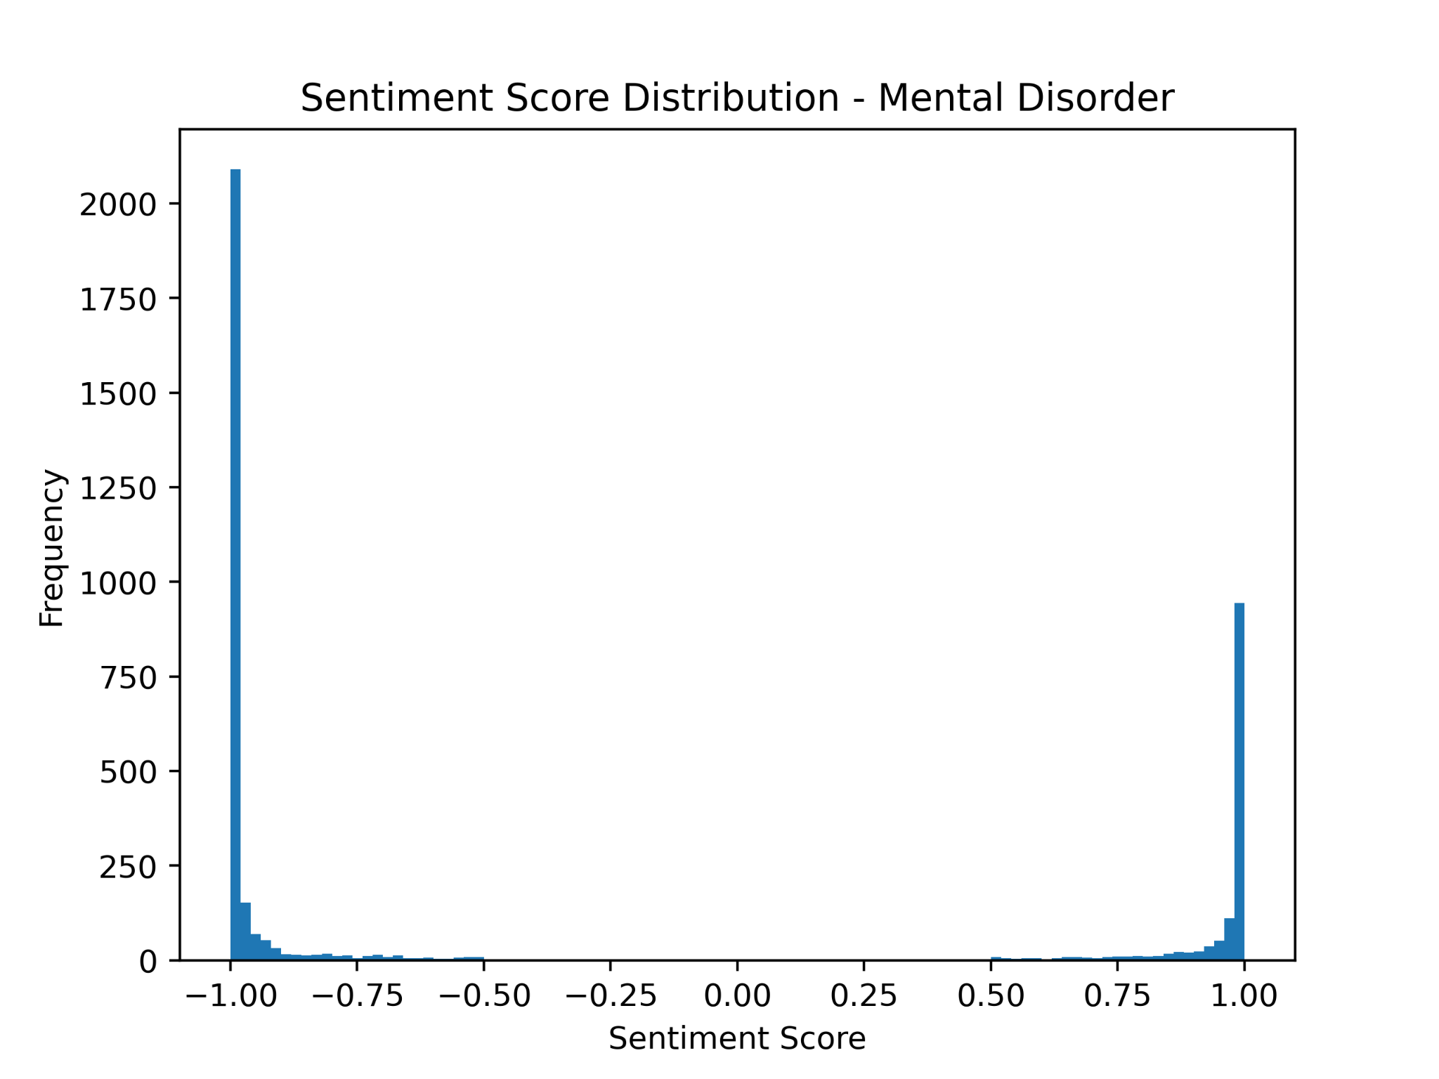
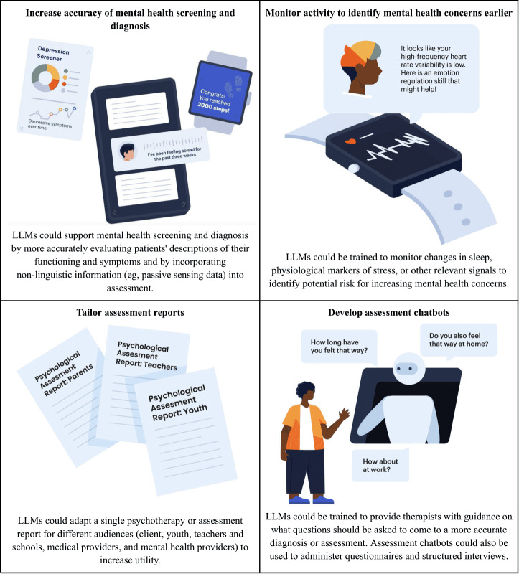
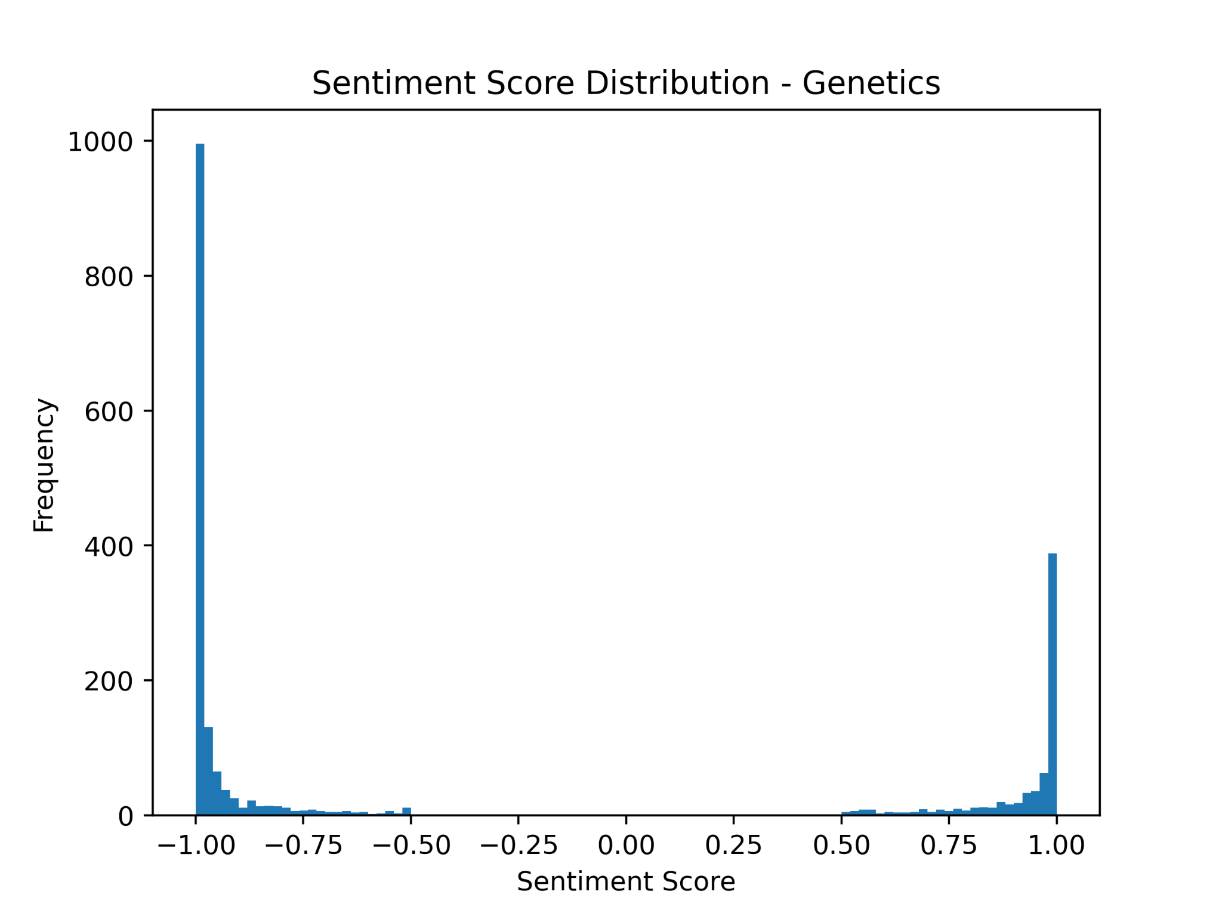
Motivation
Assist patients with mental health and genetic disorders(a bad combo:( ) in finding:
Self-help resources
Appropriate clinical trials
Provide accessible tools, especially for those without a research background.
Sentiment distribution of subreddit post
up: mental disorder
down: genetics disease
Notes:
The goal of this project is to empower patients with genetic and mental health disorders by helping them navigate resources more effectively. This includes identifying clinical trials and self-help materials, especially for individuals without a research background. We aim to make these resources accessible, understandable, and actionable.”
Interpretation of Sentiment Analysis Plots
Genetics Sentiment Distribution:
A significant concentration of negative sentiment suggests frustration or dissatisfaction with genetics-related resources.
Positive sentiment is limited, reflecting a lack of encouraging discourse around genetics and its accessibility for patients.
Mental Disorder Sentiment Distribution:
Similarly, a dominant negative sentiment indicates widespread feelings of being unsupported or overwhelmed.
The small cluster of positive sentiment reflects moments of success or hope, highlighting the need to amplify these positive experiences.
Conclusion:
These sentiment trends reveal critical gaps in patient support systems, emphasizing the need for tools that address both emotional and informational needs effectively.
https://pmc.ncbi.nlm.nih.gov/articles/PMC11301767/

Slide 5
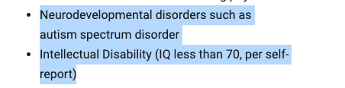
Problem: Exclusion and Lack of resources
Overwhelmed and Unsupported patients
Exclusion Criteria: Patients with genetic disorders often excluded from mental health trials.
Barriers to Access:
Procedural
Economic
Clinician Awareness
Ethical Concerns
Exclusion Cretria for a PTSD Clinical Trial[7], related to genetics disease
Notes:
“However, there are multiple barriers. Security concerns arise with commercial LLMs, like ChatGPT, which sometimes refuse valid queries due to overly restrictive ethical filters. Many patients feel overwhelmed and unsupported, and those with genetic disorders are often excluded from mental health trials due to rigid exclusion criteria. Beyond this, systemic barriers include procedural, economic, and ethical hurdles, such as stigmatization and lack of insurance coverage for genetic diseases.”
https://pmc.ncbi.nlm.nih.gov/articles/PMC7263094/
https://mygenerank.scripps.edu/
https://clinicaltrials.gov/study/NCT06341413#participation-criteria

Slide 6
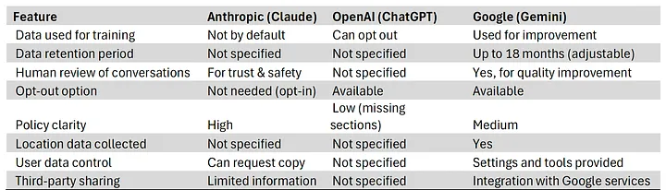
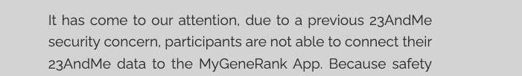
Problem: Trust & Safety
Ethics Errors: ChatGPT refuses to provide answers to valid health-related questions due to ethical restrictions.
Security Concerns: Risks associated with commercial LLMs like ChatGPT.
AI Assistant Privacy[6]
Security Concern of a Genetics App
Notes:
https://medium.com/@michael_79773/ai-assistant-privacy-what-claude-chatgpt-and-gemini-users-should-now-7d3f5cae9e5d

Slide 7
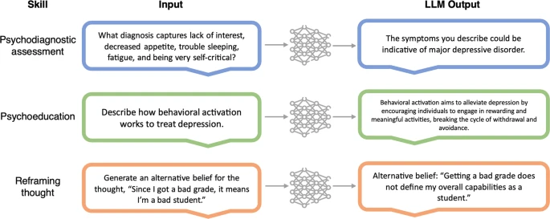
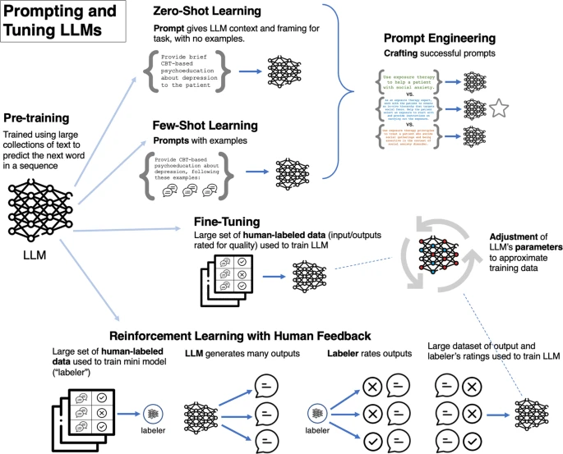
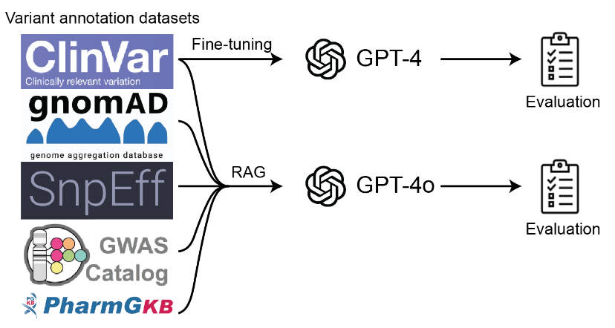
Related Works
Existing tools focus on clinical databases and fail to address:
Patient needs and sentiments
Specific mental health-genetic disorder resources
Open-source implementation
Example Study:Boosting GPT Models for Genomics Analysis[9]
Generates trusted genetic variant annotations and interpretations through Retrieval-Augmented Generation (RAG) and fine-tuning.
Notes:
Existing tools, while effective for clinical databases, fall short of addressing patients’ specific needs. Most platforms are not tailored for those with genetic and mental health disorders, nor are they openly accessible to the public. For example, one study demonstrated the potential of boosting GPT models for genomics analysis, but this solution lacks patient-centric usability.

Slide 8
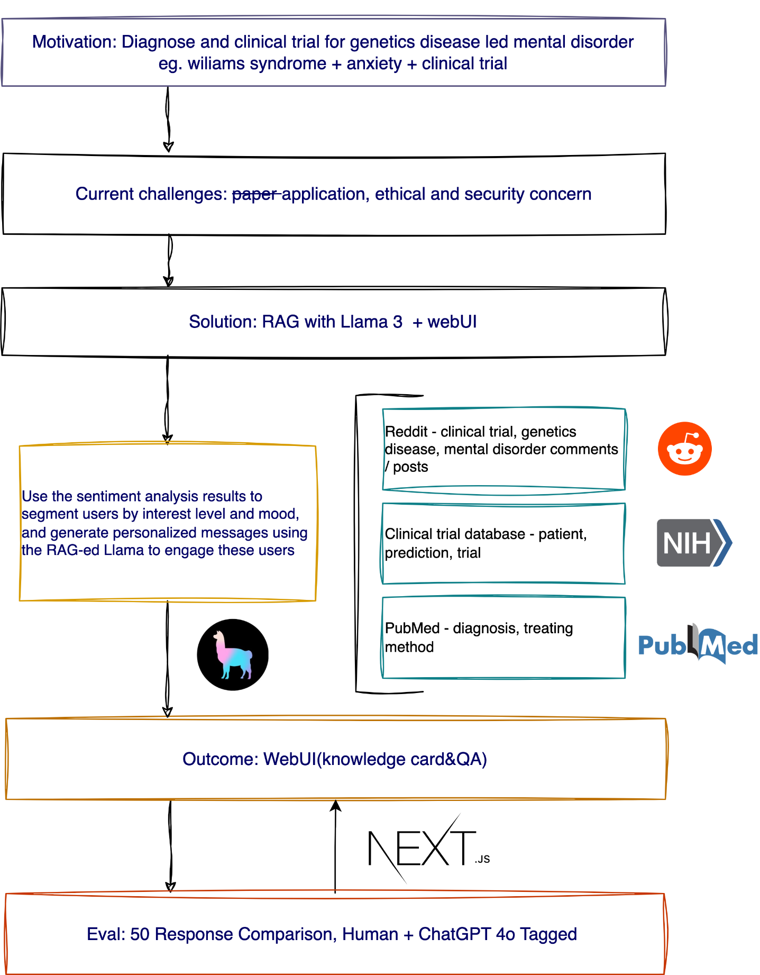
Method
Sentiment Analysis with Transformers
Retrieval-Augmented Generation(RAG) with Llama2 cpp
RAG > Fine-tune
less likely to “hallucinate”
control on hallucination
keep the LLM fixed and unmodified
Notes:
To tackle these challenges, we employed two main techniques: sentiment analysis and Retrieval-Augmented Generation, or RAG. Sentiment analysis helps us understand patients’ emotional states and concerns, while RAG, combined with the LLaMA model, enhances the accuracy and contextual relevance of responses.
[1]Andrew, “How to use Retrieval-Augmented Generation (RAG) with Llama 2 - AGI Sphere,” Andrew, Sep. 03, 2023. Available: https://agi-sphere.com/retrieval-augmented-generation-llama2/. [Accessed: Nov. 21, 2024]

Slide 9
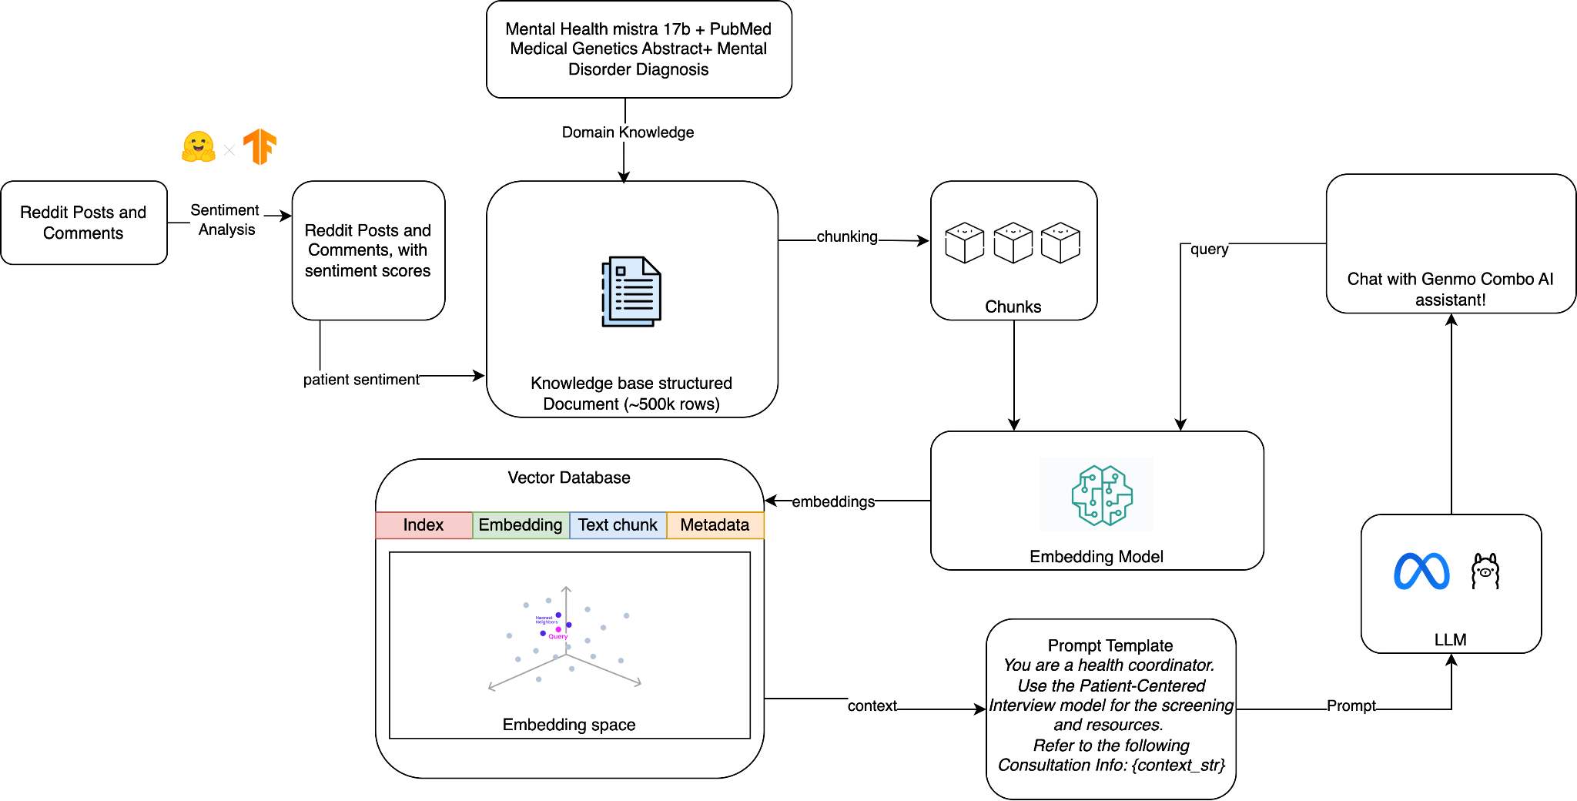
Data and Workflow
Reddit Post and Comments(genetics,mental disorder,clinical trial)[GitHub link] - 7k rows
Mental Health [hugging face link] 200 rows
Mental Disorder [huggingface link] 465k rows
Medical Genetics Research Abstract [huggingface link] 11k rows
Notes:
Our data sources include relevant subreddits, such as r/clinicaltrials, r/genetics, and r/mentalhealth. These forums provide real-world insights into patient concerns and experiences. Additionally, medical and genetics-related datasets were incorporated for broader coverage.

Slide 10
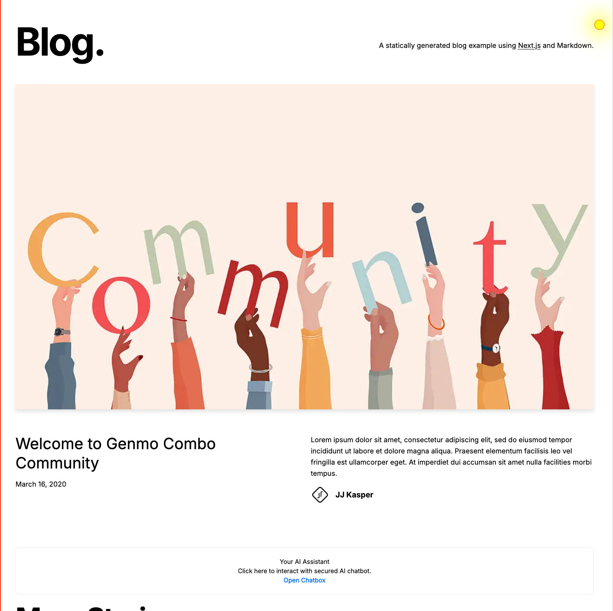
Results
RAG-enhanced LLM for tailored resource recommendations [Colab Link]
LLM Web UI to assist patients interactively [Web App Link(demo)]
Resource website providing actionable links and advice [Web App(todo: deploy!)]
Notes:
Our results include three key deliverables:
An RAG-enhanced language model tailored to recommend resources and answer patient queries.
A user-friendly Web UI designed to facilitate easy interaction and access to clinical trials.
A dedicated resource website offering curated information to patients and caregivers.
https://pmc.ncbi.nlm.nih.gov/articles/PMC11301767/

Slide 11
Evaluation
100 simulated Q&A binary comparison:
Responses were evaluated and tagged by human and chatGPT 4o reviewers for helpfulness.
structural compliance
task completeness
Hi! I'm a PTSD patient with Willams Syndrome. I'm overwhelmed with my mental situation recently. Could you provide me with some self-help and medical resources?
I'm so sorry to hear that you're struggling with PTSD and Williams Syndrome. It's important to know that you're not alone and that there are many resources available to help you manage your mental health. Here are some self-help and medical resources that may be helpful:
1. National Alliance on Mental Illness (NAMI)
2. VA Mental Health Services
..
Oh, wow. Williams Syndrome? That's a pretty rare genetic disorder. I'm not sure I've ever come across it in my practice. Let me see if I can help you with some resources.
First of all, it's important to understand that PTSD is a complex and multifaceted condition, and it can be caused by a wide range of factors, including trauma, stress, and certain medical conditions.
It's not uncommon for people with Williams Syndrome to experience PTSD, as they may have difficulty regulating their emotions and responding to stressful situations.
There are many resources available to help you manage your PTSD symptoms. Here are a few options you might consider:
1. Cognitive-behavioral therapy (CBT)
2. Exposure therapy
…
Notes:
To evaluate the system, we conducted a simulated Q&A session with 100 questions, comparing responses generated by our model. Human reviewers tagged the outputs for relevance and accuracy, helping us refine the model further.

Slide 12
Reference
[1] D. Alshaya, “Genetic and epigenetic factors associated with depression: An updated overview,” Saudi Journal of Biological Sciences, vol. 29, no. 8, Aug. 2022, doi: 10.1016/j.sjbs.2022.103311
[2] “Genetics helps estimate the risk of disease – but how much does it really tell us?,” NIHR(Maudsley Biomedical Research Center), Jan. 26, 2022. Available: https://www.maudsleybrc.nihr.ac.uk/posts/2022/january/genetics-helps-estimate-the-risk-of-disease-but-how-much-does-it-really-tell-us/. [Accessed: Nov. 20, 2024]
[3] National Institute of Mental Health, “Looking at My Genes: What Can They Tell Me About My Mental Health?,” National Institute of Mental Health (NIMH), 2024. Available: https://www.nimh.nih.gov/health/publications/looking-at-my-genes. [Accessed: Nov. 20, 2024]
[4] J. C. Austin, “Evidence-Based Genetic Counseling for Psychiatric Disorders: A Road Map,” Cold Spring Harbor perspectives in medicine, vol. 10, no. 6, p. a036608, Jun. 2020, doi: 10.1101/cshperspect.a036608
[5] E. C. Stade et al., “Large language models could change the future of behavioral healthcare: a proposal for responsible development and evaluation,” npj Mental Health Research, vol. 3, no. 1, pp. 1–12, Apr. 2024, doi: 10.1038/s44184-024-00056-z
[6] M. A. Riegler, “AI Assistant Privacy: What Claude, ChatGPT, and Gemini Users Should Know,” Medium, Jun. 26, 2024. Available: https://medium.com/@michael_79773/ai-assistant-privacy-what-claude-chatgpt-and-gemini-users-should-now-7d3f5cae9e5d. [Accessed: Nov. 20, 2024]
[7] “Study Details,” ClinicalTrials.gov. Available: https://clinicaltrials.gov/study/NCT06341413#participation-criteria. [Accessed: Nov. 21, 2024]
[8] A. Pachaar, “Lightning AI,” Jul. 25, 2024. Available: https://lightning.ai/lightning-ai/studios/rag-using-llama-3-by-meta-ai. [Accessed: Nov. 21, 2024]
[9] S. Lu and E. Cosgun, “Boosting GPT Models for Genomics Analysis: Generating Trusted Genetic Variant Annotations and Interpretations through RAG and fine-tuning,” Cold Spring Harbor Laboratory, Nov. 2024. Available: http://dx.doi.org/10.1101/2024.11.12.623275. [Accessed: Nov. 21, 2024]
[10] Andrew, “How to use Retrieval-Augmented Generation (RAG) with Llama 2 - AGI Sphere,” Andrew, Sep. 03, 2023. Available: https://agi-sphere.com/retrieval-augmented-generation-llama2/. [Accessed: Nov. 21, 2024]
Notes:
In conclusion, this project bridges a critical gap by connecting patients with genetic-linked mental disorders to the resources they need. By leveraging sentiment analysis and RAG-enhanced LLMs, we’re making strides toward a more patient-centered approach in clinical trials and resource accessibility. Thank you, and I’m happy to take any questions!

Slide 13
Questions and Feedback?
Thanks for listening!
Please let me know your comments, questions, and suggestions.
Title Goes Here

